Slide 1

Unit 2: Op-Amp Applications
Applications of Op-amp
Differential Amplifiers, Instrumentation Amplifier, Isolation amplifier
Pre – preparation: Lecture Materials and LIC Text book by ROY Choudhury, sixth edition, 2022.

Slide 2
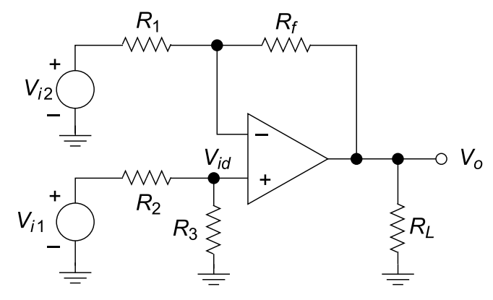

Differential Amplifier
Differential Amplifier with single Op-amp is similar to a difference Op-Amp.
Using superposition, when one input is grounded, the circuit behaves as an inverting or non-inverting amplifier, depending on which input is active.
When both inputs are applied, the output voltage becomes Vo = Vi1 − Vi2, confirming differential amplifier operation.
In practical op-amps, resistor mismatch causes a small common-mode output, defined using Vcm = (Vi1 + Vi2)/2.
The quality of a differential amplifier is measured by CMRR

Slide 3
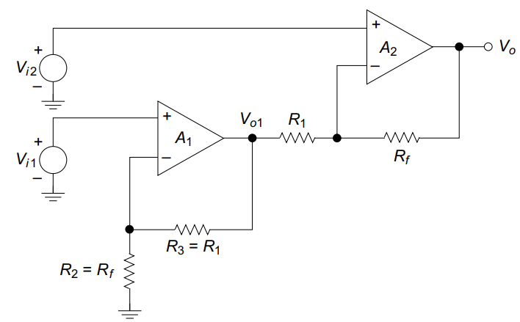
Differential Amplifier with two Op-Amps
A two-op-amp differential amplifier increases gain and input resistance compared to a single op-amp configuration.
The first stage (A₁) is a non-inverting amplifier, producing V_{o1}.
The second stage (A₂) acts as a differential amplifier, amplifying V_{i2} and V_{o1} with opposite polarities.
With R_{f} = R₃ and R₁ = R₂, the output depends on the difference V_{id} = V_{i2} − V_{i1}

Slide 4
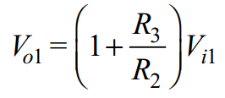
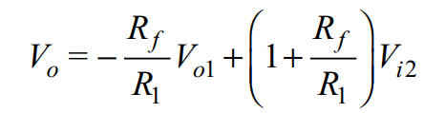
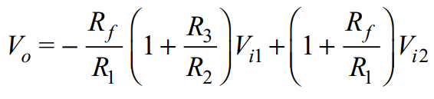
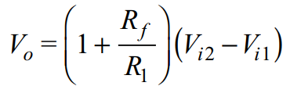

Slide 5
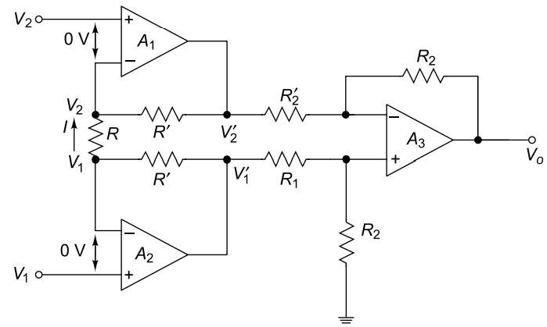
Instrumentation Amplifier
Industrial transducers (temperature, pressure, humidity, light, strain gauges, etc.) produce very small signals typically µV to mV.

Slide 6
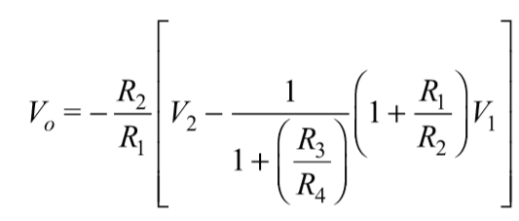


Instrumentation Amplifier
Industrial transducers (temperature, pressure, humidity, light, strain gauges, etc.) produce very small signals typically µV to mV.
These signals ride on large common-mode voltages (noise, ground offsets, interference).
Hence, a special amplifier topology is required → Instrumentation Amplifier (IA).
For the basic difference amplifier:

Slide 7
Limitations of difference amplifier
CMRR depends entirely on resistor matching
Gain adjustment requires changing multiple resistors
High gain requires large R₂/R₁​, which increases noise and resistor mismatch error.
The three-op-amp instrumentation amplifier consists of:
Differential Input Buffer Stage (A1, A2)
Difference Amplifier Stage (A3)

Slide 8

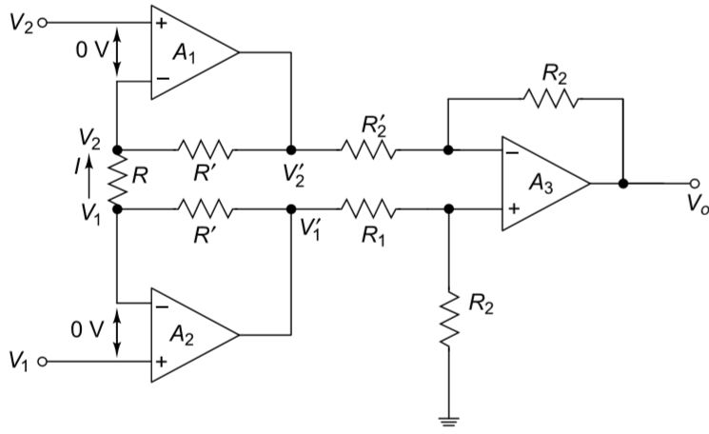



Schematic of Instrumentation amplifier

Slide 9

Merits of Instrumentation Amplifier
Gain depends on only one resistor 𝑅
Resistor matching in stage 2 is fixed and factory-trimmed
High gain achievable without degrading CMRR

Slide 10
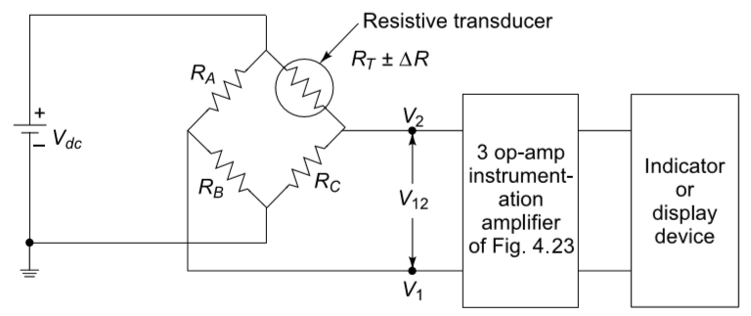

Slide 11
Unit 2: Op-Amp Applications
Applications of Op-amp
Precision Rectifier, Log & Anti-log Amplifiers, Schmitt Trigger, Comparator, Sample and Hold Circuits.
Pre – preparation: Lecture Materials and LIC Text book by ROY Choudhury, sixth edition, 2022.

Slide 12
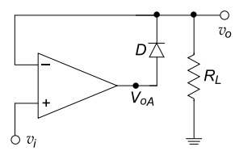
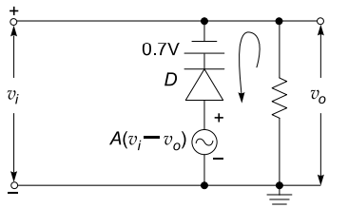

Precision Rectifier
Ordinary Si diodes have a cut-in voltage of 0.7 V which impedes efficient rectification
The circuit consists of an op-amp with a diode connected in the feedback path. The op-amp has a very high open-loop gain.
Because of this large gain, even a very small difference between the input and output causes the op-amp output to swing sufficiently to overcome the diode’s forward voltage. This effectively cancels the 0.7 V drop.
When the input voltage becomes positive, the op-amp output also becomes positive due to amplification even if input is 7 uV considering gain of 10⁵

Slide 13
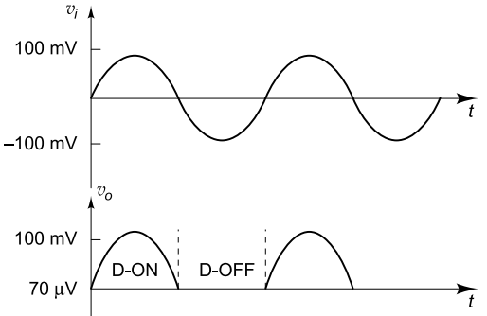
Precision Rectifier

Slide 14
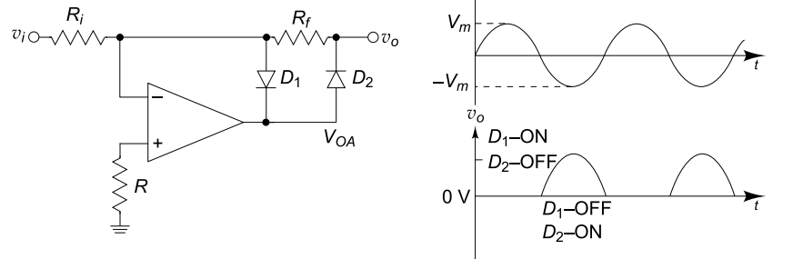
Precision Inverse Half Wave Rectifier

Slide 15
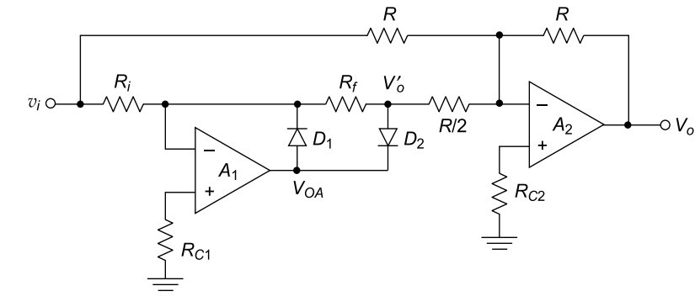
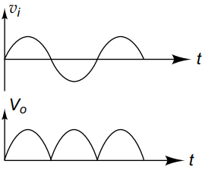
Precision Full Wave Rectifier
When vi>0: D1 off and D2 ON. V`₀=-vi
Now vi through R/2 and vi through R act as inputs to summing amplifier with unity gain.
So inputs will be V₀=-2V`₀-vi so V0=vi
When vi<0:
D1-ON and D2-OFF. V`0 = 0
Input to summing amplifier is only from vi so output V0=-vi. Positive half cycle appears at output.

Slide 16
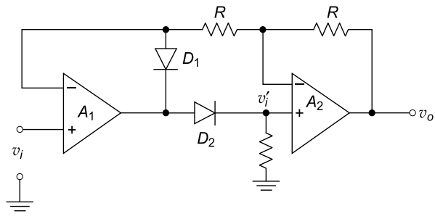
Absolute value circuit.
The following full wave rectifier converts the negative values to positive values.
Hence called absolute value rectifier.

Slide 17
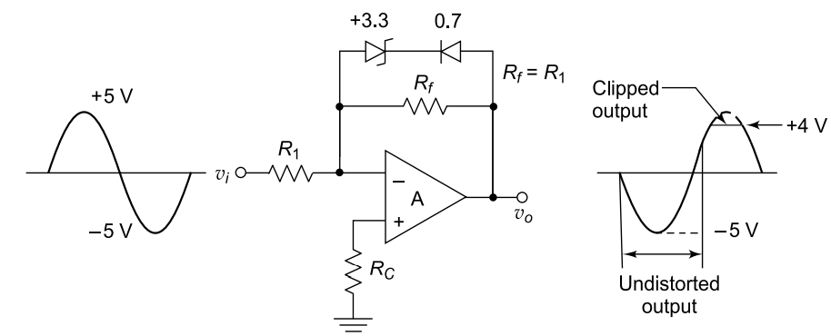
Clippers
Wave-shaping circuits modify signal amplitude (limit, clip, clamp) without changing frequency.
Diode ON → feedback loop complete Diode OFF → feedback open Enables half-wave or full-wave rectification.

Slide 18
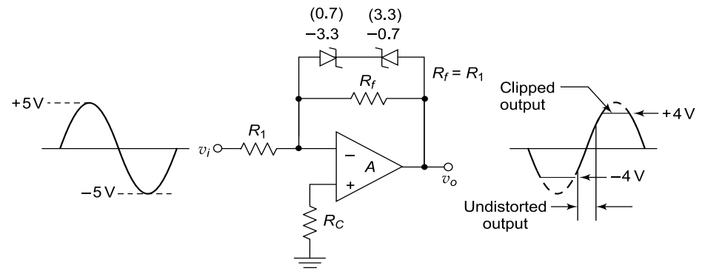
An op-amp clipper (amplitude limiter) is essentially an inverting amplifier with a Zener diode and a signal diode placed in the feedback path. The gain remains −𝑅_{𝑓}/𝑅₁ when the diodes are inactive.
When ∣vo∣<(V_{Z}+V_{D}) → diodes OFF Circuit acts as normal inverting amplifier (Av=−Rf/R1).
When ∣vo∣≥(V_{Z}+V_{D}​) → Zener in breakdown, diode forward biased → Output clipped at V_{Z}+V_{D}​.
Using two back-to-back Zener diodes allows clipping in both positive and negative directions. Between the two clipping thresholds, the circuit operates as a standard linear amplifier.

Slide 19
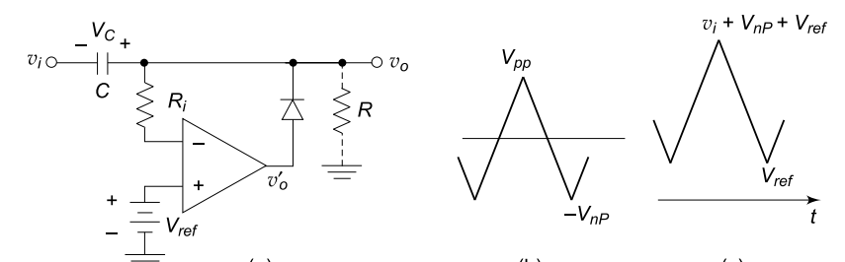
Clampers
A clamper circuit shifts the entire input waveform up or down by adding a fixed DC level, without changing its shape. It is widely used as a DC restorer (DC inserter) in television and signal processing circuits.
In a positive clamper, during the negative half-cycle the diode conducts and the capacitor charges to the negative peak value Vnp​ to maintain virtual ground.

Slide 20


Clampers
A clamper circuit shifts the entire input waveform up or down by adding a fixed DC level, without changing its shape. It is widely used as a DC restorer (DC inserter) in television and signal processing circuits.
In a positive clamper, during the negative half-cycle the diode conducts and the capacitor charges to the negative peak value V_{np}​ to maintain virtual ground.
When the input becomes positive, the diode turns OFF and the capacitor holds its charge, shifting the output such that
Adding a reference voltage V​_{ref} at the non-inverting input shifts the clamp level, giving
For negative clamping, the diode polarity and reference voltage are reversed; the capacitor charges during the positive half-cycle, shifting the waveform downward.

Slide 21
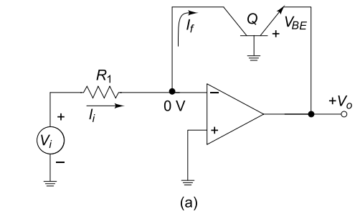



Logarithmic amplifier
Resistive feedback networks provide linear i/p to o/p relations.
Using a diode in feedback path provide logarithmic relation between i/p and o/p.
A logarithmic amplifier converts input voltage into:
V₀ α ln(V_{i})
Used in situations where large dynamic range should be handled including small and large signals (eg 10 mV to 10 V)
Transdiode with base grounded, collector to virtual ground and emitter to output.

Slide 22



From the input resistor:
Substitute VBE from previous equation:
The issues with above circuit is that Is changes with transistor design and temperature which might change the output calibration.
Hence the following configuration is used.
Two matched transistors Q1​ and Q2​ are used. Since fabricated on same silicon:
I_{S1}=I_{S2}
​ This ensures close matching and thermal tracking

Slide 23
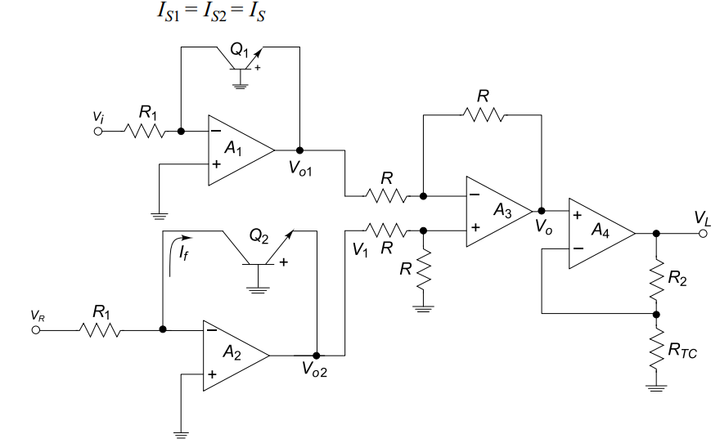

Slide 24





From first Op-amp A1:
From second Op-amp A2:
The difference amplifier A3 subtracts two outputs
Overall output at stage 4 of Op-amp A4

Slide 25

I_{S} cancels out and temperature tracking improves.
If temperature increases → this term increases linearly.
So to compensate it a temperature dependent resistor is used.
Positive temperature coefficient of RTC reduces gain when temperature rises compensating KT/q factor.
The overall output is less susceptible to temperature variations

Slide 26
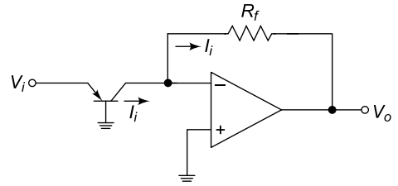



Antilog amplifier
A logarithmic amplifier converts input voltage into:
V₀ α ln(V_{i})
Antilog amplifier reverses that result
V_{o​} ∝ e^{Vi}​ or V_{o} ​∝ 10^{Vi}​
Used in cases analog multiplication, division, exponentiation etc.
Transdiode with base grounded, collector to inverting input terminal of Op-amp, emitter toinput signal.
Input voltage is same as the voltage across V_{BE}
The output voltage is derived as

Slide 27
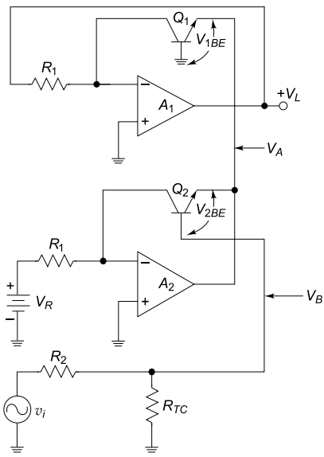


Antilog amplifier faces the same issues as the log amplifier.
Hence compensated circuit is used which is shown below.
The red regions are simple log amplifier sections. So

Slide 28



Antilog amplifier
Now V_{B}=V_{BE2}-V_{BE1}
So V_{B}=

Slide 29






Antilog amplifier
Now substitute V_{B} values:

Slide 30
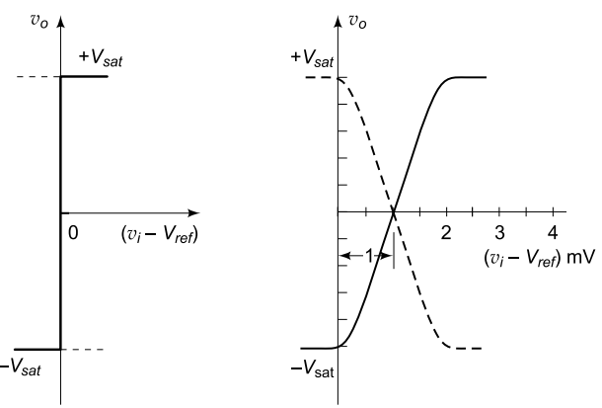
Op-Amp Comparator
An Op-amp comparator compares the input voltage with a certain reference voltage and produces either of two outputs ±Vsat.
Op-amp comparator is constructed using open-loop configuration either in inverting or non-inverting mode.
The practical and ideal characteristics of an ideal Op-amp are shown on right side.
In practical comparator there is an approximate 2mV transition period during which the output is uncertain due Op-amp offset voltage.
An inverting comparator produces -Vsat when Vi>Vref
A non-inverting comparator produces Vsat when Vi>Vref

Slide 31
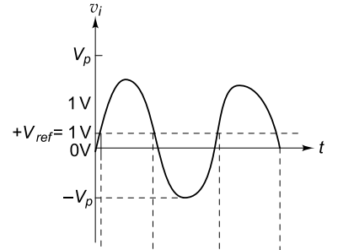
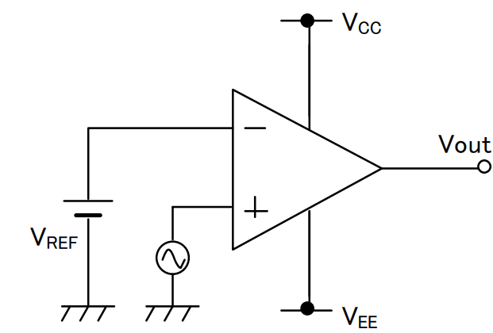
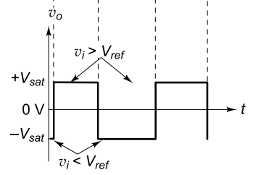
Op-Amp Comparator
Figure shown a inverting comparator.
When Vi>Vref, a positive differential voltage appears at Op-amp inputs giving Vsat at output
When Vi<Vref, a negative differential voltage appears at Op-amp inputs giving -Vsat at output

Slide 32
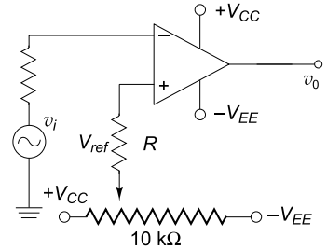
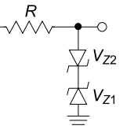
Op-Amp Comparator
The reference voltage can be obtained using voltage divider circuit from V_{cc} and –V_{EE} using a potentiometer.
The output voltage other than saturation voltage can be obtained using the Zener diodes at the output.
For the circuit shown, the output goes +Vsat when Vi>Vref.
Applications:
Zero crossing detector (sine wave to square wave converter)
Amplitude distribution analyser
Pulse-time modulator
Window detector
Timing marker signal generator
Phase detector

Slide 33
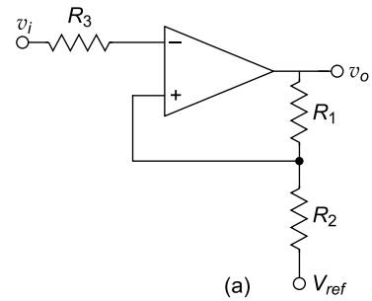
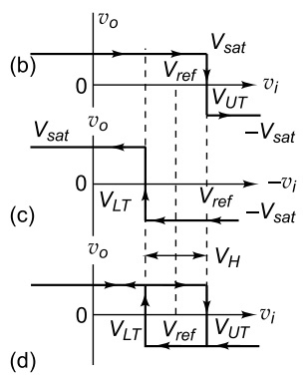


Schmitt trigger
A false triggering can happen in simple comparator due to input noise owing to high open loop gain of Op-amp.
To avoid that a positive feedback is provided from the output called regenerative comparator.
The positive feedback creates infinite closed loop gain if feedback gain is kept to unity.
Positive feedback creates two different switching levels. It remembers previous state.
If V0=+Vsat then output flips only Vi>V+. This voltage is called upper threshold voltage.

Slide 34


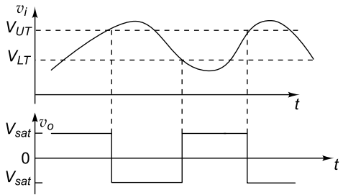
Schmitt trigger
When V0=-Vsat, the output flips when Vi exceeds the following voltage:
It can be observed that VH is independent of V_{ref}. If Vref is made 0, then a symmetrical square wave is produced at output

Slide 35
Merits
The Schmitt trigger produced two threshold switching output at VLT and VUT.
The circuit switches its output only when input changes after certain threshold.
Hence circuit is immune to noise signals.
The Schmitt trigger produces clean square waves making switching more deterministic and avoids false triggering.
Applications:
Converting Slow Analog Signals to Clean Digital Signals
Clock Signal Conditioning
Threshold Detection with Stability
Improving Noise Margin in Digital Logic

Slide 36

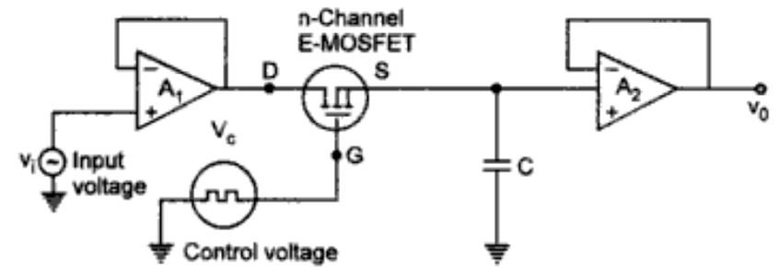
Sample and Hold circuit
A Sample and Hold circuit samples an analog input voltage, holds that value constant for a period of time.
During sampleing:
During hold:
The MOSFET in the circuit acts as the sampling circuit. The frequency of the control voltage VC determines the sampling frequency.
The first amplifier acts as a simple voltage follower for the input signal.
The control voltage to gate of MOSFET dictates the status of MOSFET ON/OFF.

Slide 37
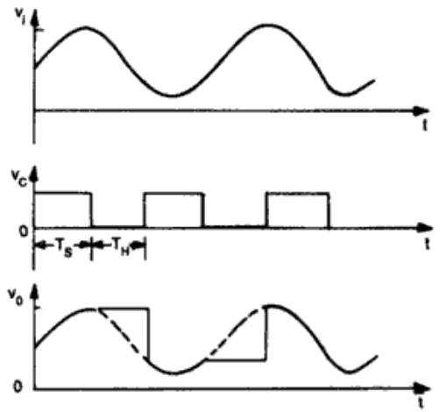
Sample and Hold circuit
When Vc is positive, MOSFET is ON.
Capacitor charges with time constant (R0+rds)C. The entire input waveform appears at non-inverting terminal of Op-amp2.
When Vc is negative, MOSFET is OFF. Since, Rin of Op-amp is very high the capacitor holds the previous charge with output staying at the voltage on capacitor.
For a proper sampling of the signal, the control voltage frequency should be atleast twice the input signal frequency.
Applications of sample and hold circuit include ADCs, Pulse Amplitude Measurement, digital oscilloscopes etc.

Slide 38


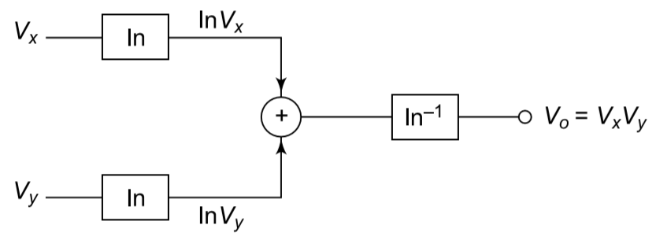
Analog Voltage Multiplier
There are multiple configurations for an Analog voltage multiplier.
One of the ways is log-antilog configuration. The outputs of log amplifiers are summed together.
The circuit operation is based on the logarithmic identity.
Since operational amplifiers can accurately add voltages, multiplication becomes practically realizable after converting signals into logarithmic form.
The summed logarithmic voltage is applied to another transistor configured as an antilog amplifier.
For voltage division give the output of
log amplifier to a difference amplifier.

Slide 39
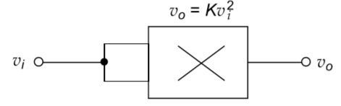
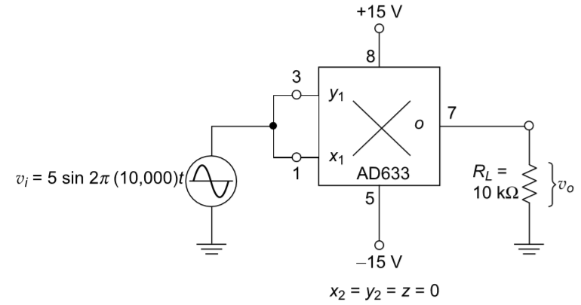

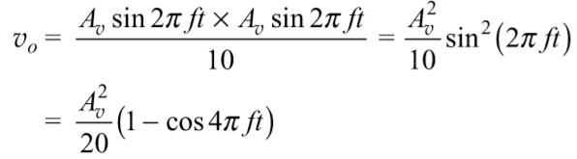
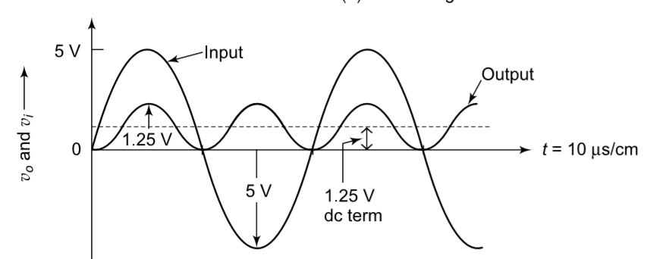
Applications
Voltage Squarer
For the above described multiplier configuration supply both the input voltages as equal signals.
Frequency Doubler:
The same voltage squarer when given with two signals of same frequency, the the output voltage turns out to be

Slide 40
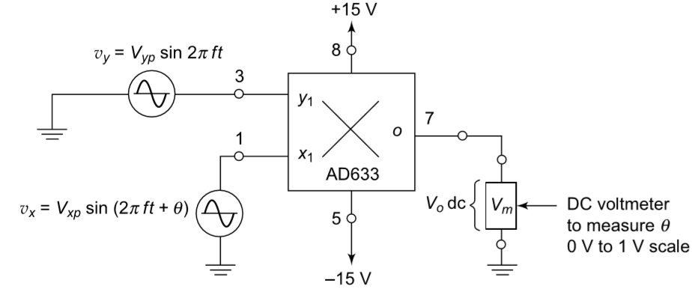
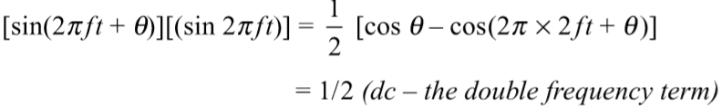
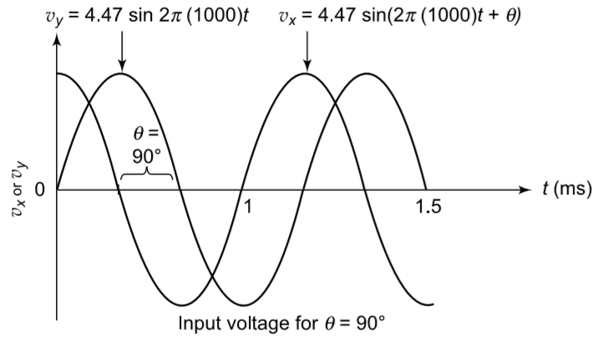

Phase angle detector:
When the inputs are given to the voltage multiplier with different phase angles the sinusoidal terms get multiplied.
The values of vxp and vyp represent peak amplitudes of input signals. A scaling factor of 10 is deployed for the multiplier configuration.
From the DC component, the phase can be calculated using phase angle meter.

